Slide 1
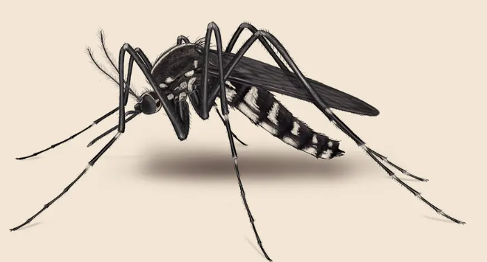
Principles of dengue virus evolvability derived from genotype-fitness maps in human and mosquito cells
Patrick T Dolan, Shuhei Taguwa, Mauricio Aguilar Rangel

Slide 2
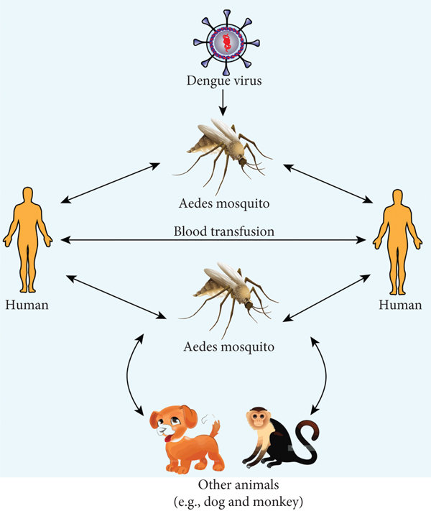
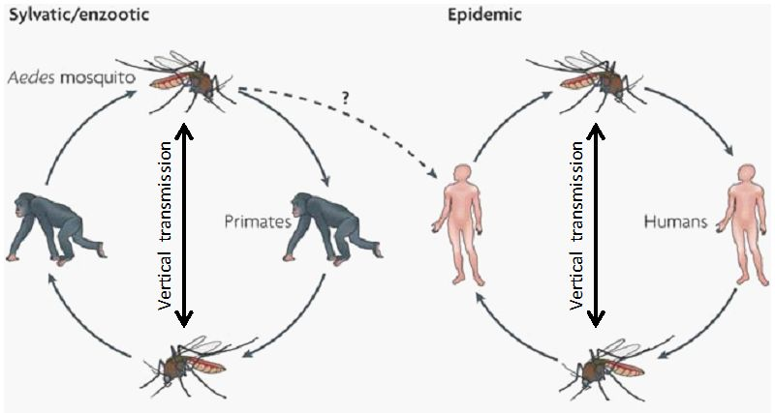
Notes:
serial passage

Slide 3
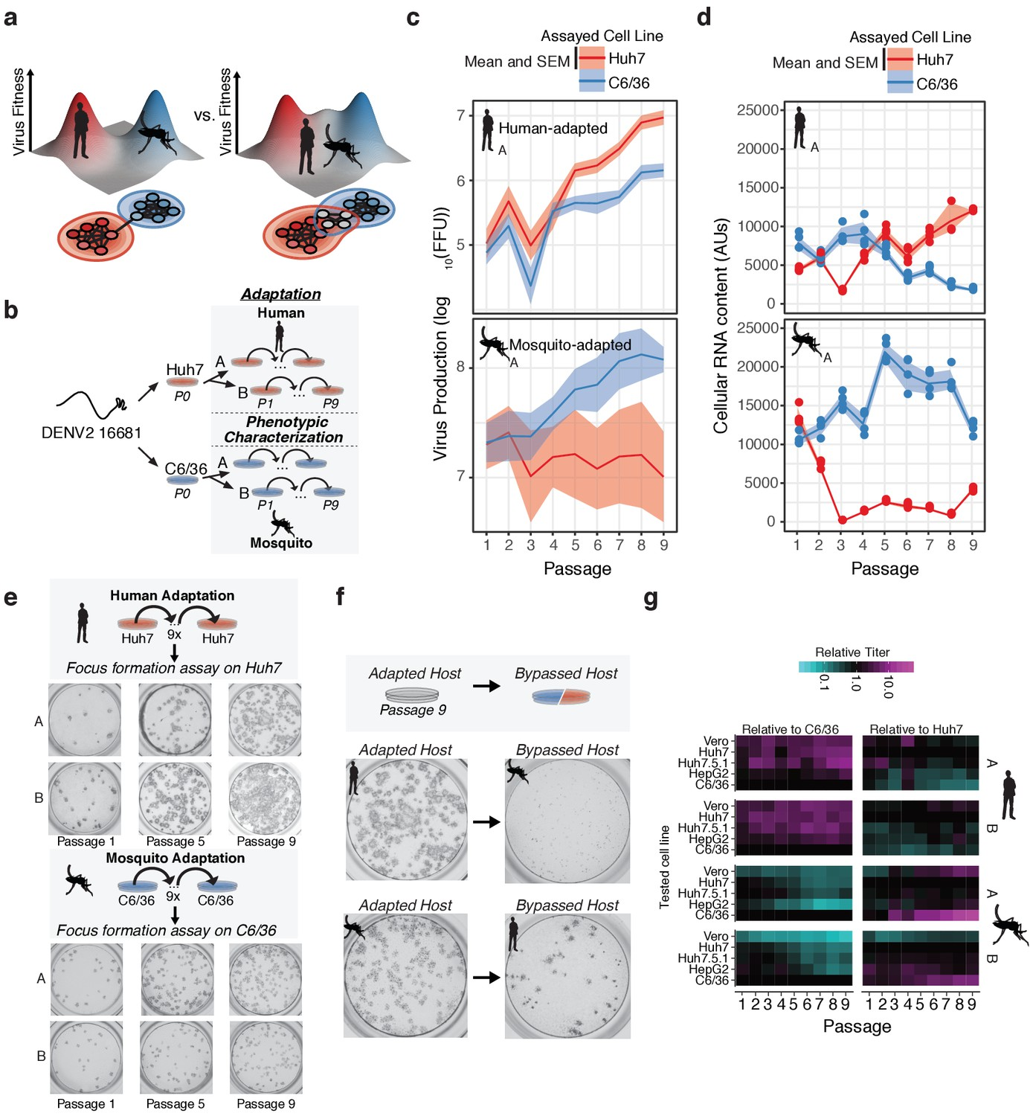

Slide 4
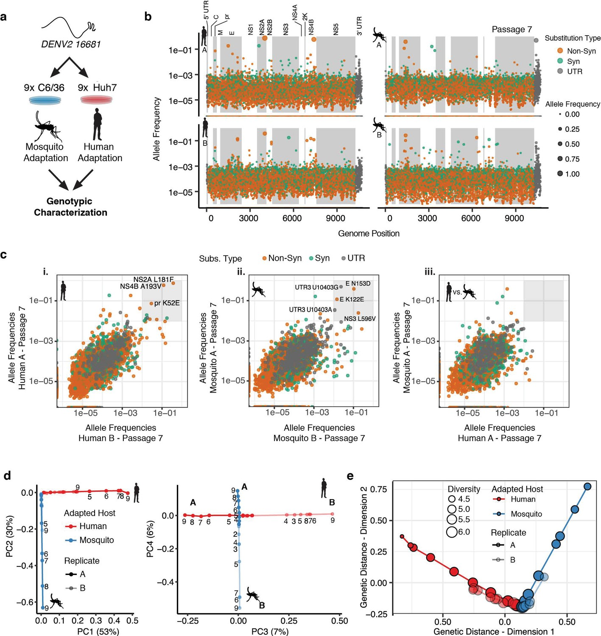
Notes:
CirSeq RNA sequencing

Slide 5
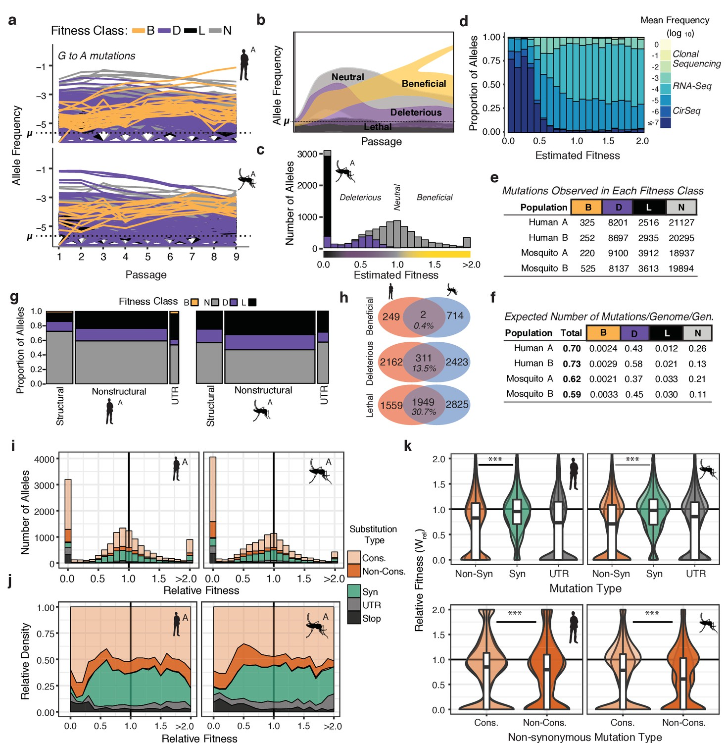

Slide 6
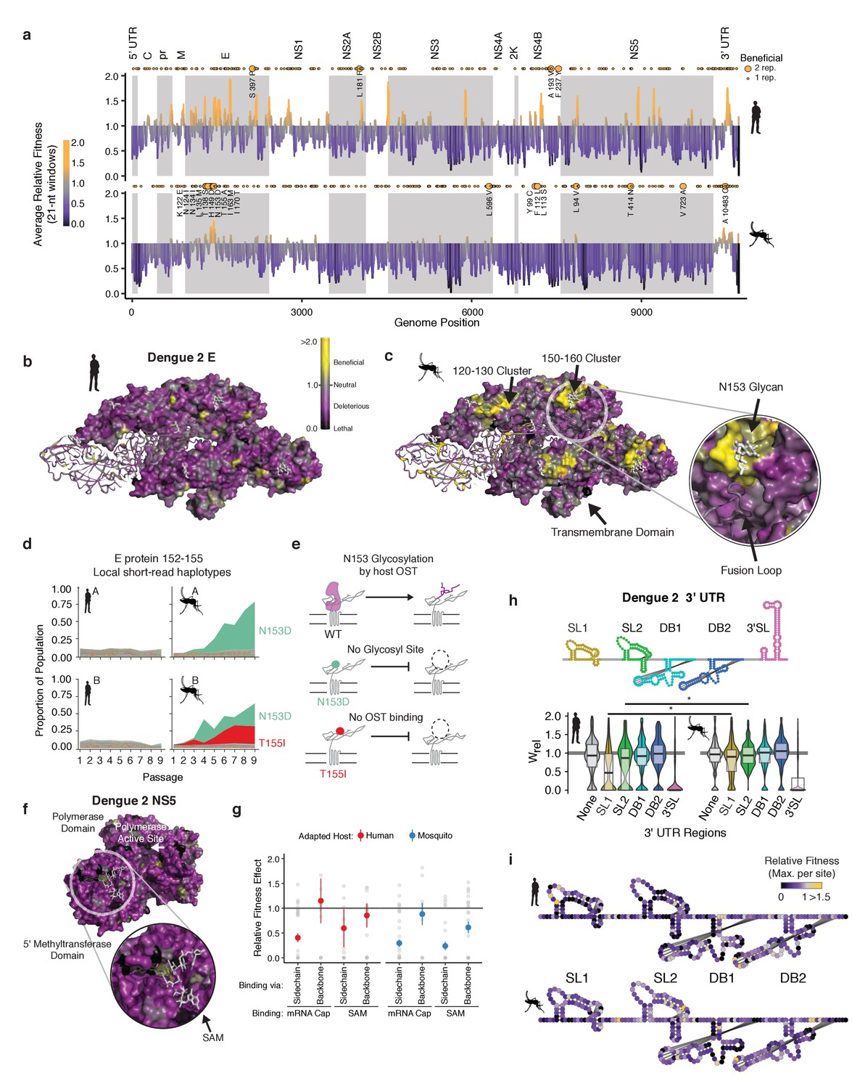
Notes:
deleterious (purple) and lethal (black) mean fitness effects
regions in non-structural proteins NS3, NS4B, NS5, and in the UTRs shared regions of strong negative selection in both hosts, which may denote key structural and functional elements.

